Slide 1
Computational Physics (Lecture 17)
PHY4061

Slide 2
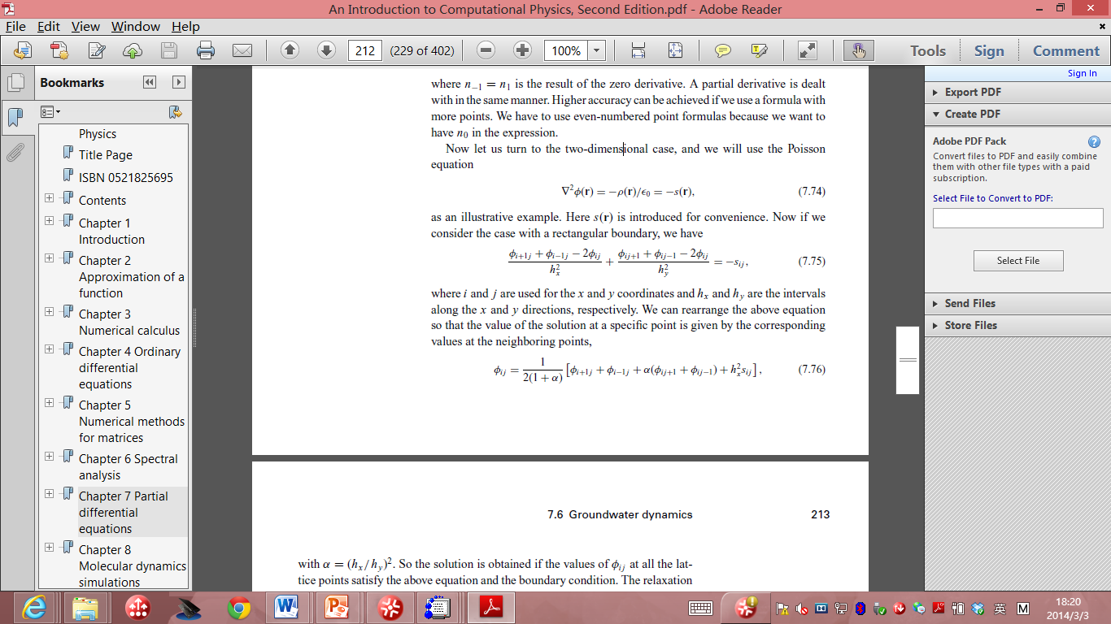
Now let us turn to the two-dimensional case, and we will use the Poisson equation:
if we consider the case with a rectangular boundary, we have
where i and j are used for the x and y coordinates and hx and hy are the intervals
along the x and y directions, respectively.

Slide 3
We can rearrange the above equation so that the value of the solution at a specific point is given by the corresponding values at the neighboring points:
with α = (hx/hy )².

Slide 4
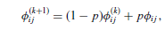
The solution is obtained if the values of φ_{i j} at all the lattice points satisfy the above equation and the boundary condition.
We first guess a solution that satisfies the boundary condition.
Then we can update or improve the guessed solution with
where p is an adjustable parameter close to 1. Here φ^{(k)}_{i j} is the result of the
kth iteration, and φ_{i j} is obtained with φ^{(k)}_{i j} used on the right-hand side of the equation on the last page.

Slide 5
The second part of the above equation can be viewed as the correction to the solution, because it is obtained through the differential equation.
The choice of p determines the speed of convergence.
If p is selected outside the allowed range by the specific geometry and discretization,
the algorithm will be unstable.

Slide 6
The optimized p is somewhere between 0 and 2.
In practice, we can find the optimized p easily by just running the program for a few iterations, say, ten, with different values of p.
The convergence can be analyzed easily with the result from iterations of each choice of p.
Mathematically, one can place an upper limit on p but in practice, this is not really necessary, because it is much easier to test the choice of p numerically.

Slide 7
Initial-value problems
Typical initial-value problems:
time-dependent diffusion equation,
the time-dependent wave equation
Some are non-linear:
the equation for a stretched elastic string
the Navier–Stokes equation in fluid dynamics.
apply the Fourier transform for the time variable of the equation to reduce it to a stationary equation
which can be solved by the relaxation method
The time dependence can be obtained
with an inverse Fourier transform
after the solution of the corresponding stationary case is obtained.

Slide 8
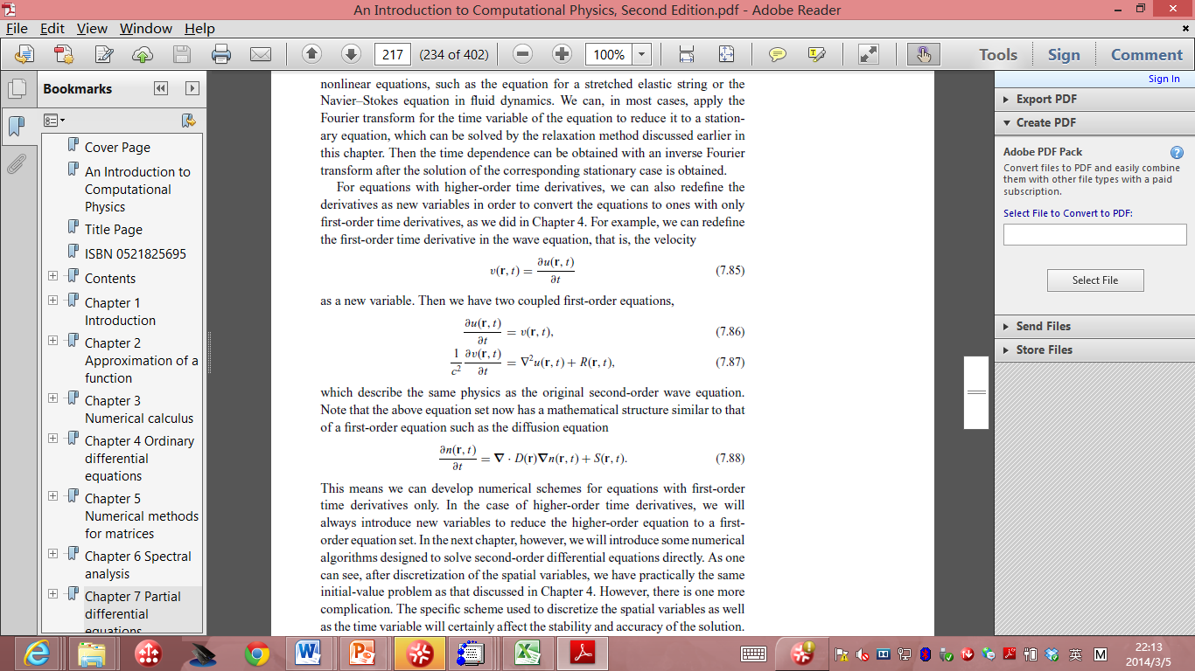
For equations with higher-order time derivatives
redefine the derivatives and convert the equations to ones with only first-order time derivatives.
For example, we can redefine the first-order time derivative in the wave equation, the velocity:

Slide 9
Then we have two coupled first-order equations:
the above equation set now is similar to a first-order equation such as the diffusion equation:

Slide 10
This means we can develop numerical schemes for equations with first-order time derivatives only.
In the case of higher-order time derivatives, we will always introduce new variables to reduce the higher-order equation to a first order equation set.
After discretization of the spatial variables, we have practically the same initial-value problem as that discussed in ODE Chapter.
However, there is one more complication.
The specific scheme used to discretize the spatial variables as well as the time variable will certainly affect the stability and accuracy of the solution.

Slide 11
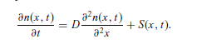
To analyze the stability of the problem, let us first consider the one dimensional diffusion equation:
If we discretize
the first-order time derivative by means of the two-point formula with an interval τ
the second-order spatial derivative by means of the three-point formula with an interval h, we obtain a difference equation
n_{i} (t + τ ) = n_{i} (t) + γ [n_{i+1} (t) + n_{i−1} (t) − 2n_{i} (t)] + τ S_{i} (t),
which is the result of the Euler method

Slide 12
Here γ = Dτ/h² is a measure of the relative sizes between the space and the time intervals.
Note that we have used n_{i} (t) =n(x_{i} , t) for notational convenience.
So the problem is solved if we know the initial value n(x, 0) and the source S(x, t).
However, this algorithm is unstable if γ is significantly larger than 1/2.

Slide 13
A better scheme is the Crank–Nicolson method,
which modifies the Euler method by using the average of the second-order spatial derivative and the source at t and t + τ on the right-hand side of the equation,
resulting in: n_{i} (t + τ ) = n_{i} (t) + 1/2{[H_{i} n_{i} (t) + τ S_{i} (t)] + [H_{i} n_{i} (t + τ ) + τ S_{i} (t + τ )]},
where we have used H_{i} n_{i} (t) = γ [n_{i+1} (t) + n_{i-1} (t) − 2n_{i} (t)] to simplify the notation.
The implicit iterative scheme can be rewritten into the form: (2 − H_{i} )n_{i} (t + τ ) = (2 + H_{i} ) n_{i} (t) + τ [S_{i} (t) + S_{i} (t + τ )].
a linear equation set with a tridiagonal coefficient matrix, which can easily be solved
the algorithm is stable for any γ and converges as h → 0, and that the error in the solution is on the order of h²
One question: How about high dimensional problems?

Slide 14
However, the above tridiagonal matrix does not hold if the system is in a higher dimensional space.
There are two ways to deal with this problem in practice.
We can discretize the equation in the same manner and then solve the resulting linear equation set with some other methods, such as the Gaussian elimination scheme or a general LU decomposition scheme for a full matrix.
A more practical approach is to deal with each spatial coordinate separately.

Slide 15
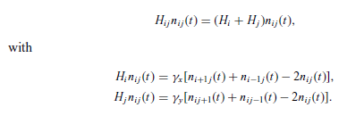
For example, if we are dealing with the two-dimensional diffusion equation, we have

Slide 16
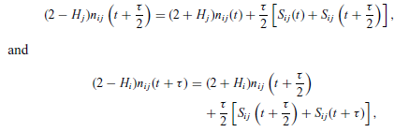
Here γ_{x} = Dτ/h_{x} ² and γ_{y} = Dτ/h_{y} ².
The decomposition of Hi j into H_{i} and H_{j} can be used to take one half of each time step along the x direction and the other half along the y direction with

Slide 17
in each of the above two steps, we have a tridiagonal coefficient matrix.
We still have to be careful in using the Peaceman–Rachford algorithm.
the convergence in the Peaceman–Rachford algorithm can sometimes be very slow in practice.

Slide 18
For a few more examples
Temperature field of a nuclear waste rod problem
Ground water dynamics
Just read Tao Pang’s book if you are interested in them.

Slide 19
Principles of Parallel computers and some Impacts on their programming models
Key technology developed in the last 25 years in solving scientific, mathematical and technical problems.
A broad spectrum of parallel architectures has been developed.

Slide 20
A parallel algorithm can be efficiently implemented
Only if it is designed for the specific needs
Basic introduction to the architectures of parallel computers.

Slide 21
Overview of architecture principles
The first super computer architectures
The use of one or a few of the fastest processors
By increasing the packing density, minimizing switching time, heavily pipelining the system and employing vector processing techniques.

Slide 22
Vector processing:
Highly effective for certain numerically intensive applications.
Much less effective in commercial uses like online transaction processing or databases.
Computational speed was achieved
At substantial costs: highly specialized architectural hardware design and renunciation of such techniques as virtual memory.

Slide 23
Another way is to use multiprocessor systems (MPS).
Only small changes to earlier uniprocessor systems.
By adding a number of processor elements of the same type to multiply the performance of a single processor machine.
The essential fact of a unified global memory could be maintained.

Slide 24
Later, the unified global memory is not required.
The total memory is distributed over the total number of processors
Each one has a fraction in the form of a local memory.

Slide 25
Massively parallel processors appeared in 80’s.
Using low cost standard processors to achieve far greater computational power.
One problem:
For the use of such systems
Development of appropriate programming models.

Slide 26
No standard models.
A few competing models
Message passing, data-parallel programming, virtual shared memory concept.
Efficient use of parallel computers with distributed memory requires:
Exploitation of data locality.

Slide 27
If the performance needs increase:
A cluster of interconnected workstations can be considered as a parallel machine.
The interconnection network of such clusters is characterized by relatively small bandwidths and high latency.

Slide 28
We can realize integrate massively parallel processors, multiprocessor systems, cluster of interconnected workstations, vector computers into a network environment and combine them to form a heterogeneous super computer.
Message-passing interface (MPI) is a landmark achievement in making such systems programmable.

Slide 29
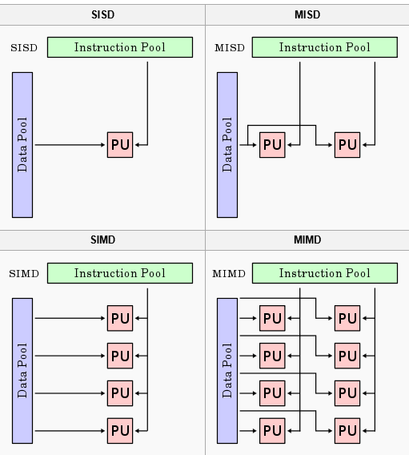
Flynn’s classification of computer architectures

Slide 30
Message passing multicomputers:
The processors in a multiprocessor system communicate with each other through shared variables in a common memory, each node in a multicomputer system has a local memory, not shared with other nodes.
Interprocessor communication is done through message passing.

Slide 31
Massively parallel processor systems
Hundreds or several thousands of identical processors, each has its own memory.
Distributed memory multicomputers are most useful for problems that can be broken into many relatively independent parts.
The interaction should be small
Interprocessor communication can degrade the system performance.
Limiting factors: bandwidth and latency.

Slide 32
Message passing programming model
The communication channels are mapped onto the communication network.
The communication hardware is capable of operating independently of its assigned compute node so that communication and computation can be done concurrently.

Slide 33
The efficiency is determined by the quality of mapping the process graph with its communication edges onto the distributed memory architecture.
In the ideal case,
Each task gets its own processor, every communication channel corresponds with a direct physical link between both communication nodes.

Slide 34
Available processors in massively parallel systems.
Scalability requires a relatively simple communication network.
Compromises are unavoidable.
For example: a logical communication channel is routed when it passes one or more grid points. The transfer of data takes time. If there is no hardware support, routing must be done by software emulation.

Slide 35
On one hand, communication paths with different delays arise by non-optimal mapping of communication channels onto the network.
On the other hand, several logical channels are multiplexed on one physical link.
Therefore, usable communication bandwidth is decreased.

Slide 36
In recent years, adaptive parallel algorithms are developed.
The decision of how to imbed the actual process graph into the processor graph can’t be made statically at the compile time, but only at the runtime.
Newly created tasks should be placed on processors with less workload to ensure a load balance.
The communication paths should be kept as short as possible and not be overloaded by existing channels.

Slide 37
HW 3 (no need to do all questions)
3 options:
Finish Q1 and Q2,
Finish Q3,
Finish Q4
Suppose in a parallel world where the air resistance force is proportional to V ^{5/3}. Rewrite the motor cyclist program in C or fortran to calculate this problem show in the lecture notes 13(Assume all the parameters are the same). Show the difference between this model and the model shown in the lecture notes.

Slide 38
HW3 A
Setup and run the java code of the relaxation method shown in the lecture notes 16(You can also rewrite it in C/C++ or fortran if you don’t know how to run Java or you enjoy programming), test 10 different p values and the convergence speed, report the best choice of p values in your code. (Note that I am not asking you to provide the optimum of p among all possible choices of p.)

Slide 39
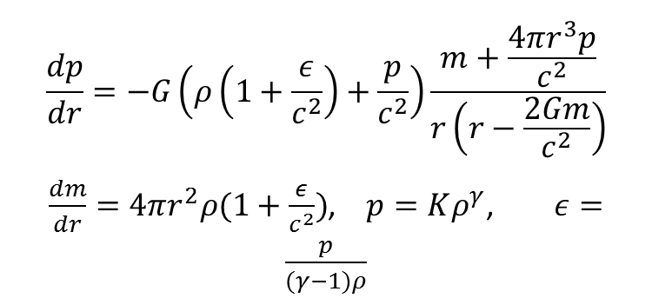
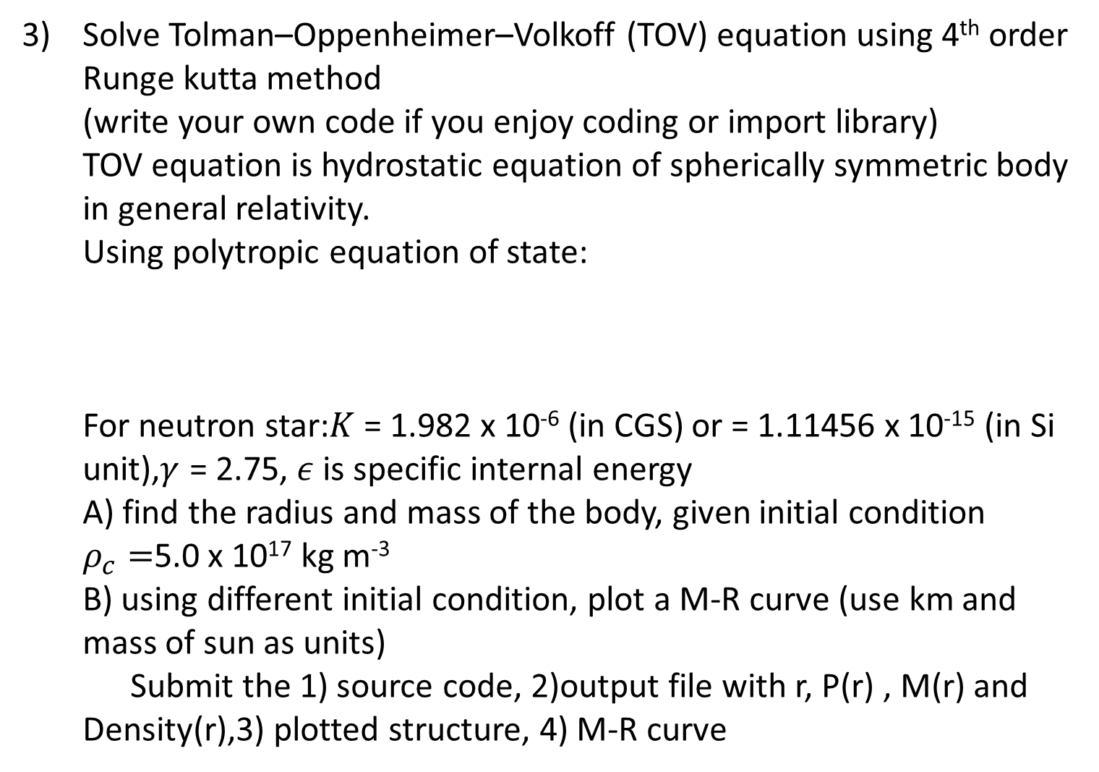
HW 3 B
Solve Tolman–Oppenheimer–Volkoff (TOV) equation using 4th order Runge kutta method (write your own code if you enjoy coding or import library) TOV equation is hydrostatic equation of spherically symmetric body in general relativity. Using polytropic equation of state: For neutron star:$K$ = 1.982 x 10⁻⁶ (in CGS) or = 1.11456 x 10⁻¹⁵ (in Si unit),$γ$ = 2.75, $ε$is specific internal energy A) find the radius and mass of the body, given initial condition $ρ_{c}=$5.0 x 10¹⁷ kg m⁻³ B) using different initial condition, plot a M-R curve (use km and mass of sun as units) Submit the 1) source code, 2)output file with r, P(r) , M(r) and Density(r),3) plotted structure, 4) M-R curve
$$\frac{dp}{dr}=−G\left(ρ\left(1+\frac{ε}{c^{2}}\right)+\frac{p}{c^{2}}\right)\frac{m+\frac{4πr^{3}p}{c^{2}}}{r\left(r−\frac{2Gm}{c^{2}}\right)}$$
$\frac{dm}{dr}=4πr^{2}ρ(1+\frac{ε}{c^{2}})$, $p=Kρ^{γ}$, $ε=\frac{p}{(γ−1)ρ}$

Slide 40
HW3 C
Or 4) Three body simulation using gravitational force Write a code for three body simulation of gravitational force. Implement Euler method and one predictor-corrector algorithm on same initial condition. Calculate the individual kinetic energy, total kinetic energy and total potential energy.
Submit the 1) source code, 2) output .xyz files of trajectory, 3) plots of the KE vs time and PE vs time in two different integration methods you chosen, 4) A small report to explain the difference in energy conservation between the two methods you used

